Slide 1
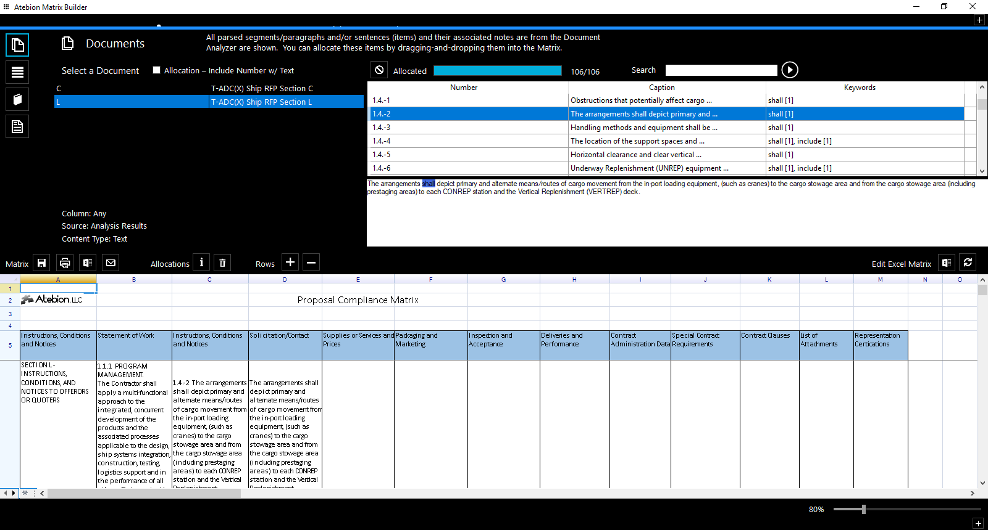
Use for allocation text without numbers

